Slide 1
WEB 3, Session 10
Reactive Programming

Slide 2
Reactive Programming
(Not React)
Wikipedia: "In computing, reactive programming is a declarative programming paradigm concerned with data streams and the propagation of change."
ReactiveX: "The Observer pattern done right"
"ReactiveX is a combination of the best ideas from the Observer pattern, the Iterator pattern, and functional programming"

Slide 3
RxJS
Reactive programming for JavaScript
Part of the ReactiveX family
Designed to consume
A Kafka Stream
A RabbitMQ queue
Web sockets
Server-send events
Far from universally used
Really good when you need it
Particularly good for event-driven architectures

Slide 4
Observer Pattern
Notes:
The classic Observer pattern. The subject sends notification to the observers when something changes.
That's okay for changing an object, but insufficient for event streams over a network.

Slide 5
Observer Pattern enhancements: Events
Event
The usual observer pattern events
Error
Because not everything succeeds
Marks the end of the event stream
Complete
An event to mark the successful end of the stream

Slide 6
Subscribing to events
const observable = ...
observable.subscribe(evt => {...})
observable.subscribe({ next(evt) {...}, error(err) {...}, complete() {}
})

Slide 7
Event Sources ("producers")
fromEvent
From DOM events
fromEvent(button, "click")
ajax
Server responses
1 event, then complete
interval
A timer that keeps sending events 0, 1, 2, 3, 4, 5, …
WebSocket
Streams web socket messages

Slide 8

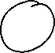

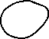
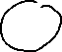
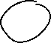
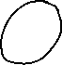

Marble Diagrams

Slide 9
Operator functions
Functions that take observables and return observables
An operator can
Transform the events
Block the events
Emit new events
Complete the stream
Emit errors
Handle errors
And combine several of the above

Slide 10
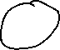
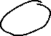
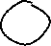
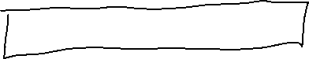
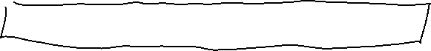
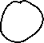
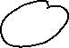
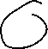
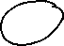

Operators and marble diagrams

Slide 11
Pipelines
observable.pipe(
map(x => 2 * x),
filter(x => x > 0)
)

Slide 12
fromEvent example
fromEvent(button, "click").pipe(
map(getText),
tap(text => console.log(text)), // For debugging.
filter(text => text !== '')
)
.subscribe(addBullet)

Slide 13
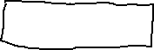

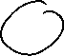
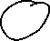

take/drop

Slide 14
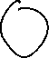
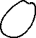
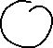
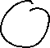


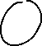


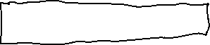
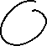

debounceTime

Slide 15

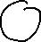

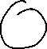
throttleTime

Slide 16
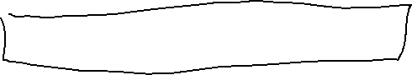
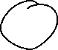
reduce

Slide 17

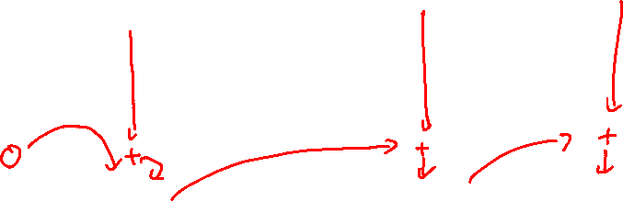
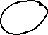
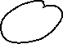
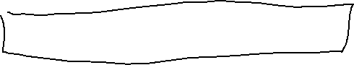
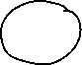


scan
Notes:
Notice how the value propagates through time with each value being added to the newly arrived event.

Slide 18
Observable vs Subject
Observable is single-cast
It can only have one subscriber
Subject is multi-cast
It can have as many subscribers as needed
Making an observable multi-cast
obs.pipe(share())

Slide 19
Sharing an observable
function subscribeToPlayerJoining(game: Game): Observable<Game> {
return gameSubscription('game_' + game.gameNumber)
.pipe(
filter(game => game.ongoing),
take(1),
share()
)
}

Slide 20
Observable of observable
When does it happen?
You consume an event stream/web socket/…
For every event you start listening to a new stream/socket/…
Typically: map() the events into streams
How to handle it? Merge or concat.
Merge
Chronological
When you want to react to the events as they happen
Concat
Ordered
When you want one stream to finish before you react to the next one

Slide 21


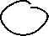



Observable of observables

Slide 22

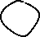



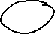
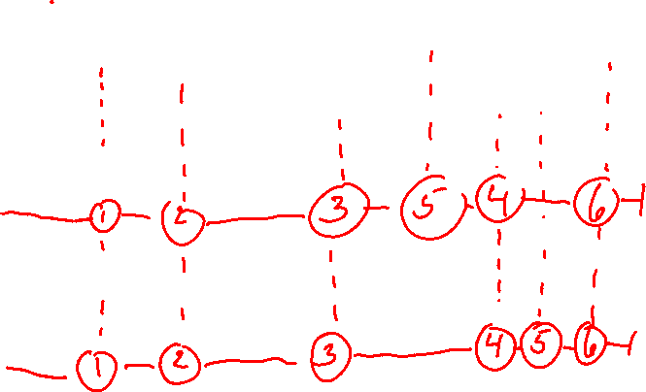
merge vs concat
Notes:
Where merge guarantees that events arrive in chronological order, concat guarantees they arrive in logical order.

Slide 23
Towards event driven architecture
Why event driven architecture?
More flexible
Lower coupling
More uniform if you have events anyway
Why not event driven architecture?
Relentlessly asynchronous
Difficult to keep things in order
Difficult to follow the flow
Let's look at 1-way data flow as an example
I do not expect you to do it or hear about it in the exam

Slide 24

The Redux flow

Slide 25
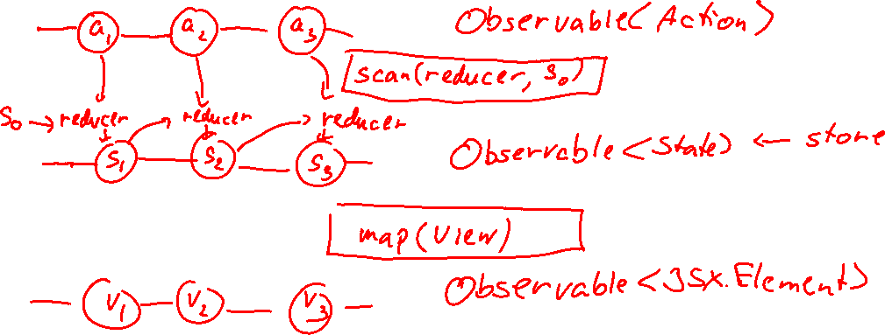
Redux flow marble diagram
Notes:
Note how the state propagates through time. This is an obvious use of scan.

Slide 26
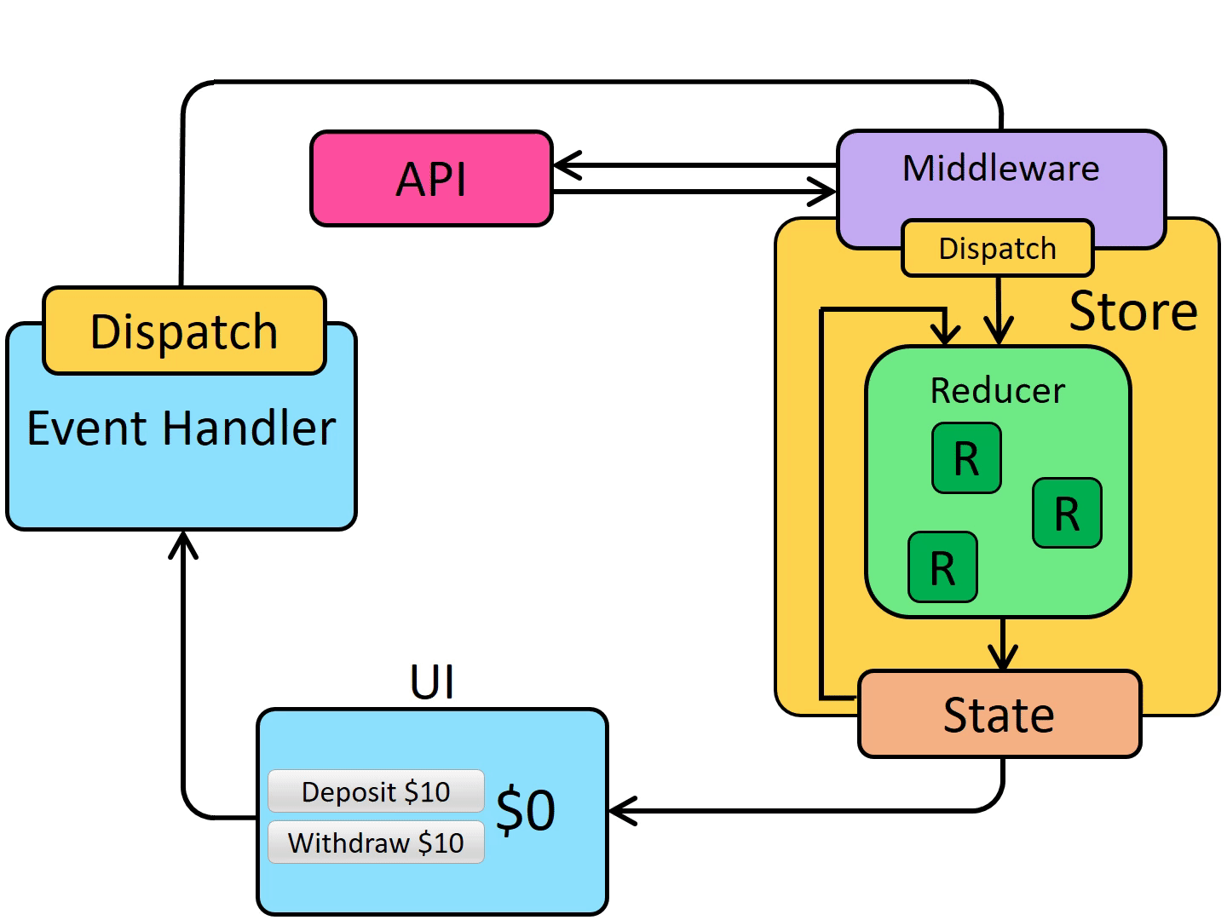
The Redux flow with middleware

Slide 27
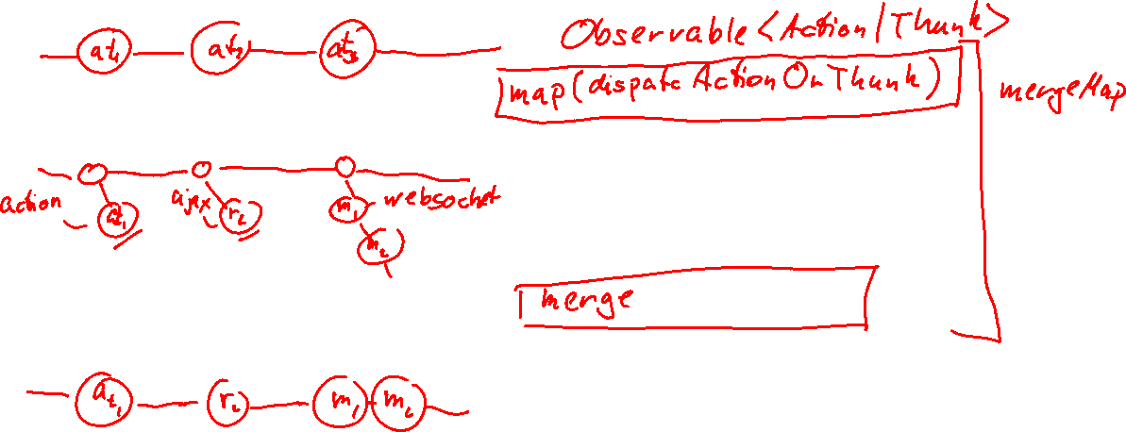
ThunkMiddleware marble diagram

Slide 28
Code for dispatch
export type Thunk = () => Observable<Action>
export const actionSource = new Subject<Thunk | Action>()
export const dispatch = (actionThunk: Thunk | Action) =>
actionSource.next(actionThunk)

Slide 29
Code for dispatchThunk
export const dispatchThunk = (actionThunk: Action | Thunk): Observable<Action> => {
if (typeof actionThunk === 'function')
return actionThunk()
else
return of(actionThunk)
}

Slide 30
Code for the Redux flow
actionSource.pipe(
mergeMap(dispatchThunk),
scan(reducer, init_state),
map(view),
).subscribe(render)

Slide 31
Conclusion
RxJS makes event handling concise
It has high level of abstraction
Use marble diagrams + the operator decision tree to design the pipeline
RxJS can theoretically replace the Redux enhanced store
I don't know if you want to

